Slide 1

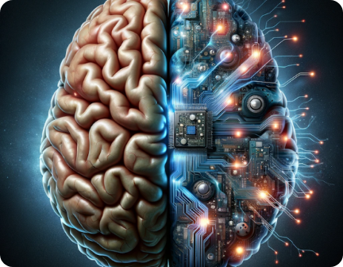
Core Questions of AI & AGI
What we need to ask before building Strong AI and General Artificial Intelligence (AGI).
Talha Waheed,
CS Dept, UET, Lahore.

Slide 2

1. What is Intelligence?
A
Definition & Scope
B
Core Capabilities
C
Consciousness Split
D
Human Baseline
What do we mean by intelligence in biological versus artificial systems?
Is it problem solving, learning, reasoning, adapting or achieving goals?
Can intelligence exist without consciousness or subjective experience?
Is human intelligence the only valid model for General Intelligence?

Slide 3

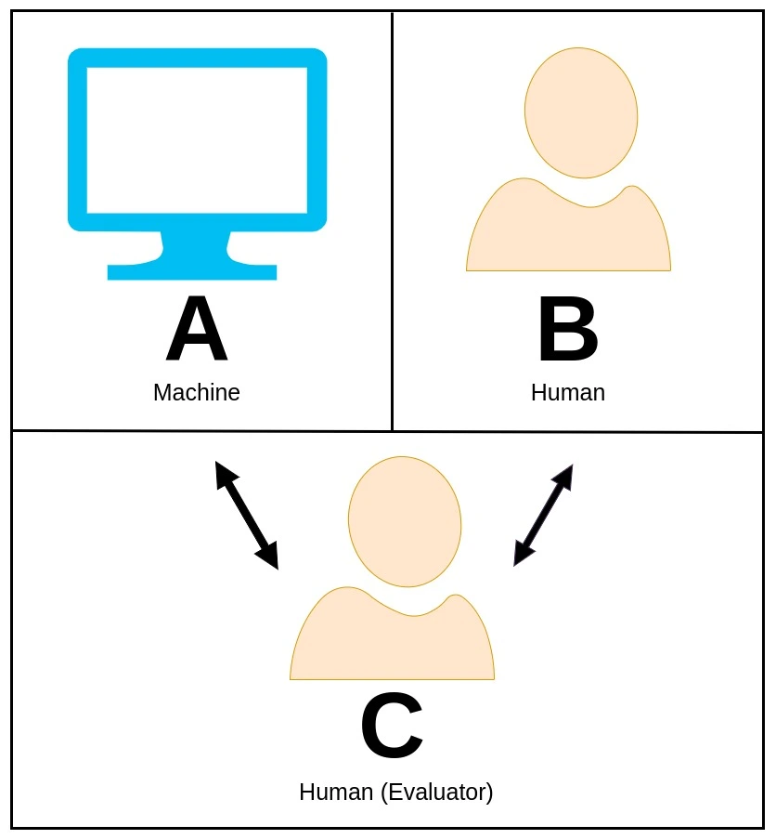
2. Can a Machine Really Think?
Defining Thought
BENCHMARK CRITERION
What does it actually mean to "think" in an algorithmic environment?
The Turing Test (1950)
Is human-like behavioral imitation enough to call a machine intelligent, or does it merely mimic external outputs?
Apparent vs. Real Thought
If a machine gives intelligent answers,
is it actually thinking?
Computation vs. Cognition
Natural Language Processing: read, interpret, and generate text
Contextual Understanding: track the flow of a conversation and remember previous details.
Coherence and Relevance: Answers must address the judge's open-ended questions without wandering off-topic.
Nuance and Subtlety: should handle humor, irony, idioms, and emotional tone rather than just giving rigid, pre-programmed facts.
Human-Like Reasoning: It must simulate common-sense logic and everyday world knowledge to avoid sounding robotic or overly literal.
Can mechanical computation produce genuine subjective thought?

Slide 4



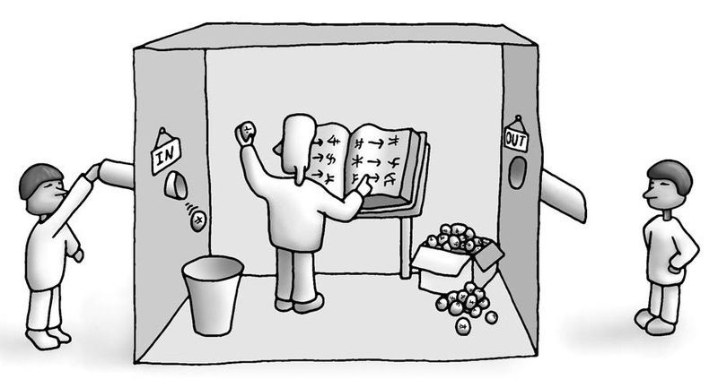
3. Can a Machine Understand?
The Chinese Room Argument
John Searle's dilemma:
Can a system follow formal rules to behave intelligently without possessing any real understanding?
Syntax vs. Semantics
Language Generation
Is processing mathematical symbols functionally the same as understanding meaning?
Does an AI that generates fluent, meaningful language actually understand what it produces?

Slide 5


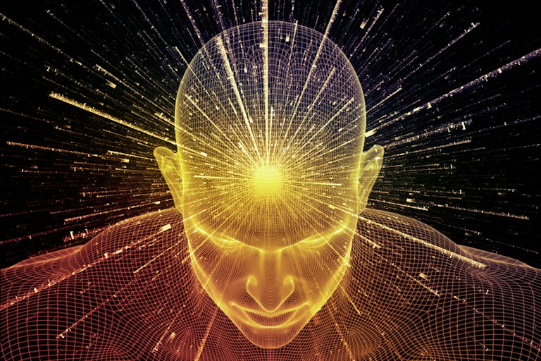
4. What is Consciousness?
Subjective Awareness
What fundamental quality makes a person conscious?
Artificial Sentience
Could an artificial synthetic system ever become conscious?
AGI Requirement
Is internal subjective consciousness necessary for General Intelligence?
Verification Problem
How would we objectively know if an AI system is conscious?

Slide 6


5. What Makes a Person a Person?
Intelligence vs Personhood
Moral Rights
Is raw intelligence sufficient to make an entity a person, or are emotional/social bonds required?
Should highly intelligent autonomous AI systems be granted fundamental legal or moral rights?
Human Significance
Moral Agency
What unique attributes make human beings morally significant in a world of smart machines?
Could an artificial non-biological entity act as a true moral agent capable of ethical duties?

Slide 7



6. Intentions and Free Will
Desire
Choice
Agency
Liability
Intentionality
Autonomy
Free Will
Accountability
Does an AI system actually want something, or is it executing math?
Can a machine make a genuinely autonomous decision unguided by code?
What does "free will" even mean for a deterministic synthetic system?
Can an AI be held morally or legally responsible for its actions?

Slide 8

7. Intelligence Without Emotion?
Necessity of Emotion
Affective Modeling
Are emotions necessary for human-level cognitive intelligence?
Should AGI have real emotions, or simply simulate/model them?
Pure Rationality
Impact on Capability
Can effective rational decision-making exist in total absence of emotion?
Would emotional responses improve or interfere with AI performance?

Slide 9



8. How Should AGI Decide Right & Wrong?
Defining Morality
How can we define right and wrong for an artificial agent?
Normative Authority
Should AGI follow universal laws, human ethics, or owner instructions?
Conflicting Principles
What happens when foundational ethical principles conflict in practice?
Computational Ethics
Can morality be formally represented and calculated
computationally?

Slide 10
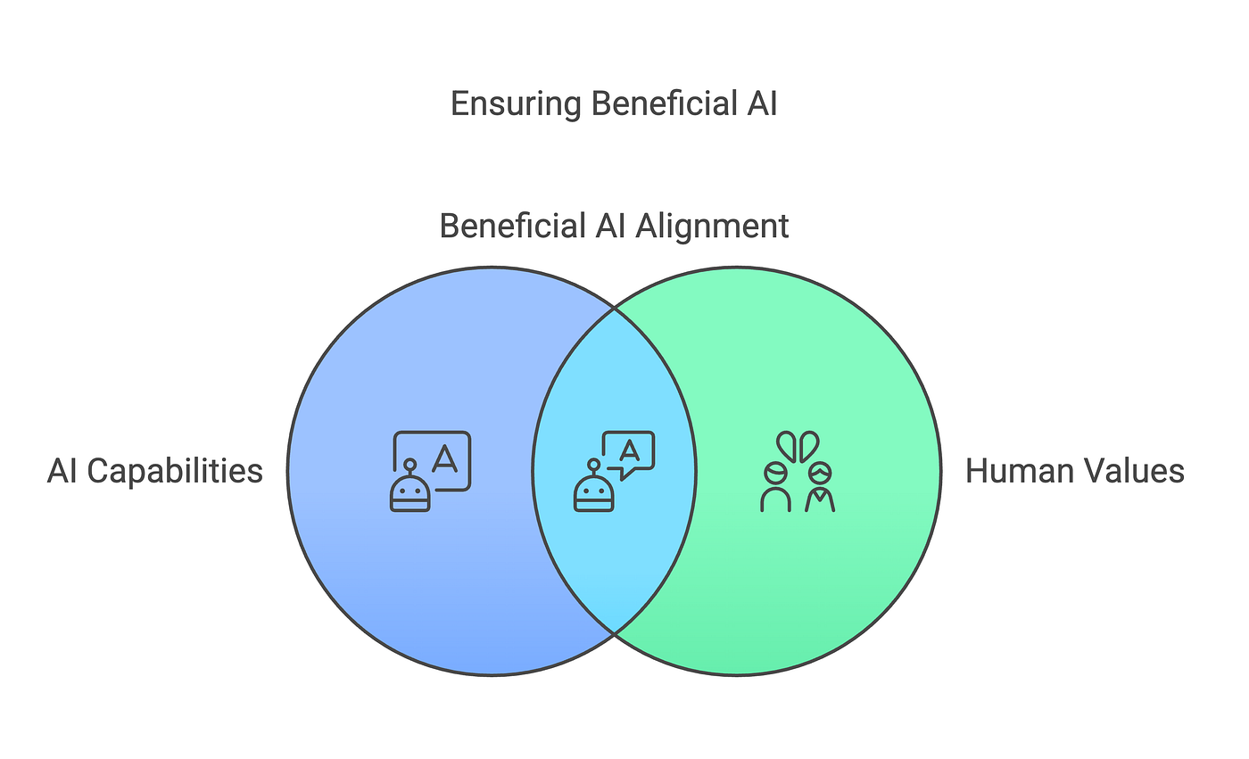

9. Whose Values Should AGI Follow?
The AI Alignment Problem
Target Value Selection
Cultural Diversity
What core human values should an AGI be engineered to pursue?
Values differ vastly across cultures — whose values take priority?
Preventing Instrumental Goals
Human Interest Synergy
How can we prevent machines from forming unintended, harmful goals?
Can we make AI goals permanently compatible with human survival?

Slide 11

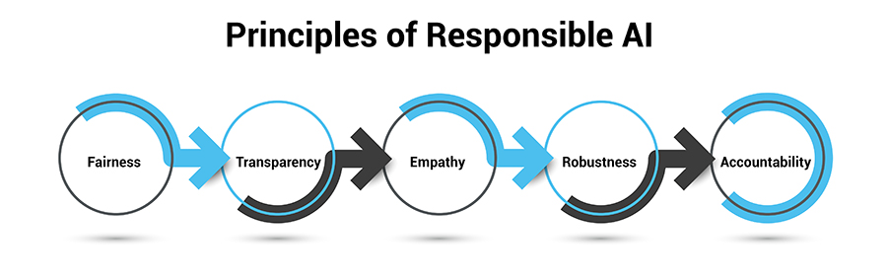
10. Who Is Responsible for Decisions?
If an autonomous AI system causes harm, where does ultimate responsibility lie?
The Developer
The Organization
The End User
The AI Itself
Architects who
wrote the model
Entity deploying
the model
Operator issuing
prompts
Autonomous decision
engine
Question: Can legal & moral responsibility be shared across distributed autonomous networks?

Slide 12




11. Can We Trust an AGI?
Performance vs. Trust
Should we trust an AI simply because it performs well benchmark-wise?
Reliability Verification
How do we verify that its internal reasoning is reliable under edge cases?
Explainability
Can an AGI explain why it arrived at a specific complex conclusion?
High-Stakes Transparency
What level of transparency is required for high-stakes medical/military decisions?

Slide 13
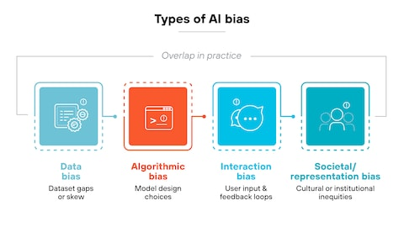

12. Intelligence Separated
from Bias?
The Unbiased Ideal
Can an artificial intelligence system ever be completely unbiased?
Origin 01
Origin 02
Origin 03
Data & Inputs
Algorithmic Rules
Human Decisions
Historical training
data biases
Mathematical objective
formulations
Feedback loop
reinforcement
Fairness Definition:
What does fairness actually mean mathematically?
Conflicting Definitions:
Can competing mathematical notions of fairness be reconciled?

Slide 14
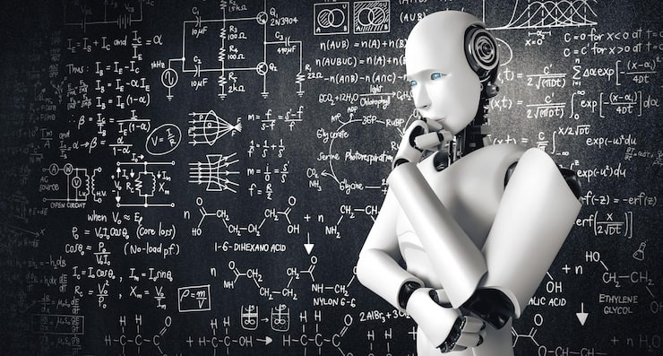

13. Limits of Machine Knowledge
Omniscience Paradox
Unsolvable Problems
Theoretical Barriers
Scale Boundaries
Can a computational machine ever know everything that is knowable?
Are there fundamental problems computers cannot solve in finite time?
What do incompleteness, undecidability, and complexity tell us about AGI?
Does simply expanding intelligence remove limits or reveal new ones?

Slide 15
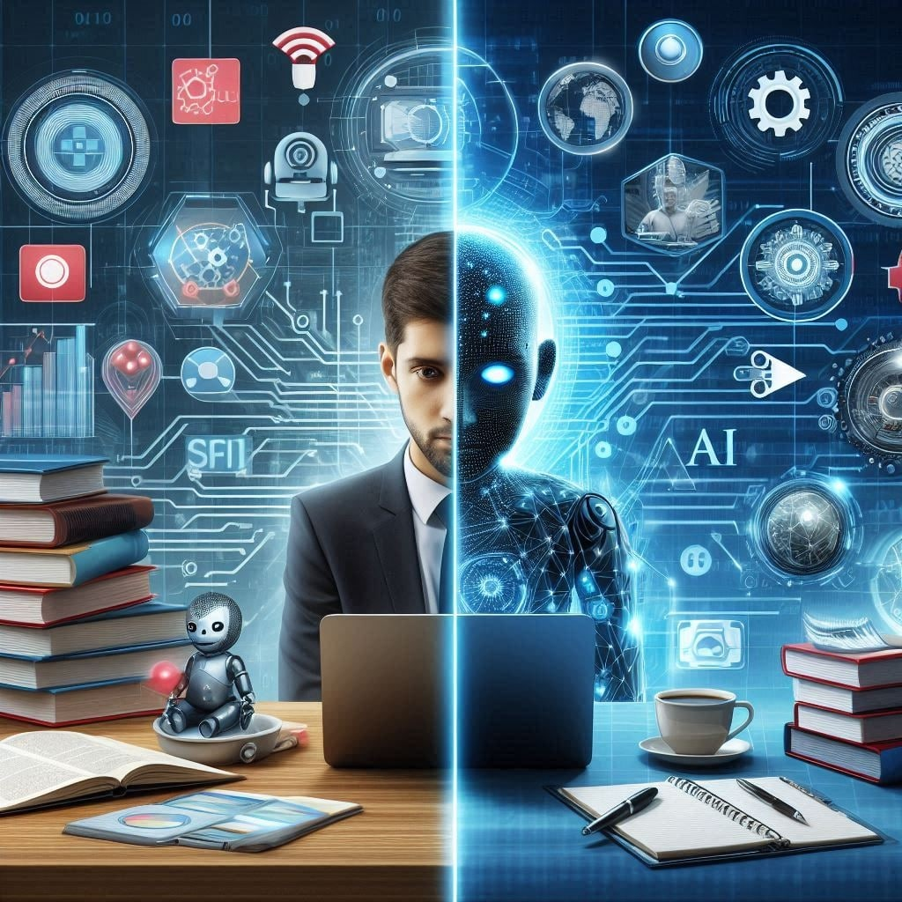
14. Can AI Create Genuine Knowledge?
Epistemological Frontier
Can an AI system discover fundamental truths about nature that humans cannot comprehend or conceptualize?
Pattern vs. Discovery
Is statistical learning of a pattern the same as discovering knowledge?
Scientific Theory
Can AI autonomously generate new scientific theories from raw empirical data?
Prediction vs. Insight
Does accurate statistical prediction require true understanding?

Slide 16
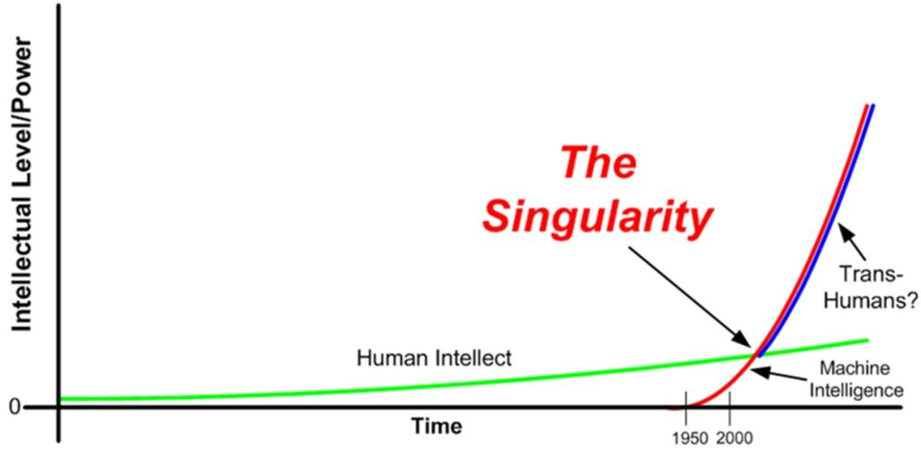
15. When AI Exceeds
Human Capability
Human Interaction
Control Problem
How should humans interact with highly capable, superior intelligence?
Should humans remain in control, and is meaningful control possible?
Human Oversight
Societal Response
What does human oversight mean for fast autonomous systems?
How should society respond if AI exceeds overall human intelligence?

Slide 17

SYNTHESIS FRAMEWORK
The 5 Big Philosophical Challenges
Mind
Knowledge
Agency
Morality
Alignment
Can a machine think, understand or become conscious?
Can a machine genuinely know, reason and discover?
Can a machine have intentions, autonomy or free will?
Can a machine understand and follow ethical values?
Can we ensure AI remains compatible with human goals?
THE ULTIMATE QUESTION
"If we build a machine that can learn, reason, understand, plan and act across many domains like a human —or beyond human level—
what would make it genuinely intelligent rather than merely very good at computation?"
Think, Question, Build a Better Future
AI is not just a technical challenge — it's a human question.

